Slide 1
Past and Present Coiled Tubing String Failures: History and Recent New Failures Mechanisms
Published by: Jalal Al Ali

Slide 2
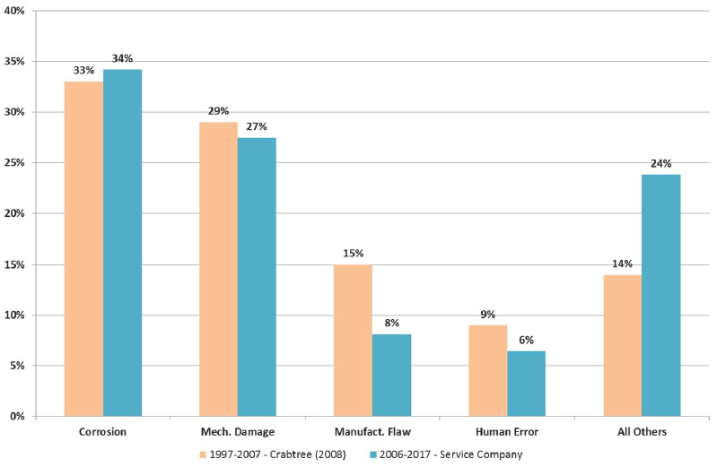
Comparison
Service Company CT Failures Fatigue data

Slide 3
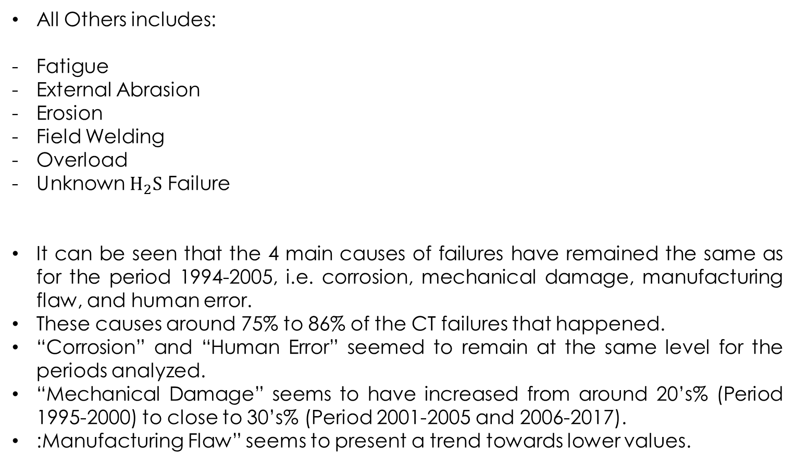
All Others includes:
Fatigue
External Abrasion
Erosion
Field Welding
Overload
Unknown $H_{2}S$ Failure
It can be seen that the 4 main causes of failures have remained the same as for the period 1994-2005, i.e. corrosion, mechanical damage, manufacturing flaw, and human error.
These causes around 75% to 86% of the CT failures that happened.
“Corrosion” and “Human Error” seemed to remain at the same level for the periods analyzed.
“Mechanical Damage” seems to have increased from around 20’s% (Period 1995-2000) to close to 30’s% (Period 2001-2005 and 2006-2017).
:Manufacturing Flaw” seems to present a trend towards lower values.

Slide 4
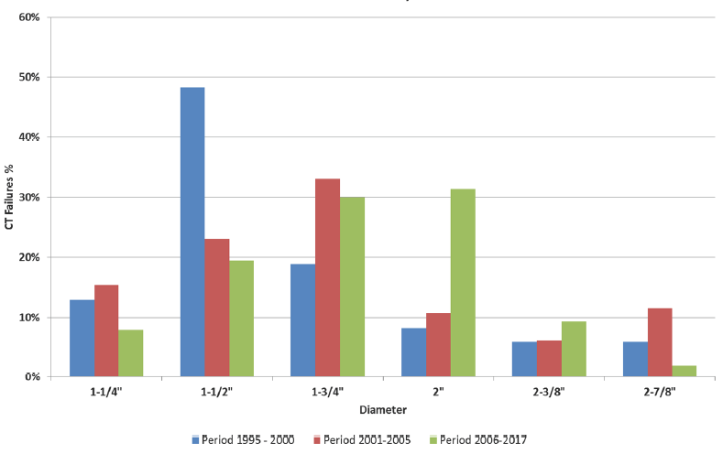
CT Failure Distribution by Pipe Diameter

Slide 5
An increase in diameter of the strings involved in the failures was observed for the period 2006-2017, with 31% corresponding to 2” and 30% to 1-3/4”
For the period 1995-2000, 48% of the failures analyzed were related to 1-1/2” diameter strings and 19% to 1-3/4”.
For the period 2001-2005, 33% of the failures corresponded to 1-3/4” diameter strings and 23% to 1-1/2”.
Within the Service Company, the most common diameters were 1-1/2” and 1-3/4” for 1997, but this trend changed for 2016-2017 with an increase of the diameter used towards 1-3/4” and 2”.

Slide 6
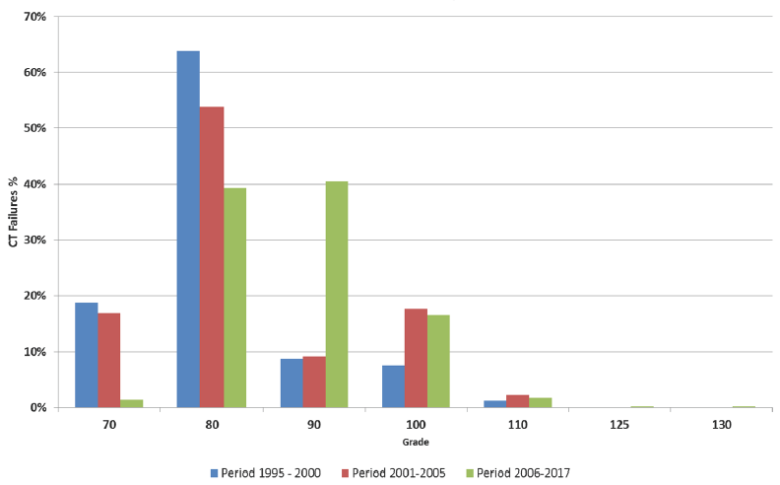
CT Failures Distribution by Pipe Grade

Slide 7
By 1997, the most common Grades were 80 and 70, but this trend changed for 2016-2017, with 90 Grade being the most common.
North America Units Operations:
Switched
General Well Intervention & Stimulation
Plug Milling Operations
“Plug Milling” operations required ever larger pipe sizes.
The change of CT Grade distribution can be contributed to two factors:
A change in material availability
A change in the acceptable operating pressure

Slide 8
Change in CT Grade Distribution
a Change in
Material Availability
The Acceptable Operating Pressure

Slide 9
Today a much wider range of materials are available and from a greater number of suppliers.
High strength materials were all introduced since 2013, when the first 130 Ksi was available.
The acceptable operating pressures have changed considerably since 1997.
At first, operations with over 4000 psi for 1.75” were considered high and strings expected to have an operational life of several years.
North America operations and unit counts had been changed, and it had been influenced significantly by this change.
Interventions frequently conducted at over 8000 psi & string life that can be better to measured in weeks.
Another factor that contributed to the increase in 90 Grade strings was the approval of this Grade for sour service within the service company at around 2009.

Slide 10
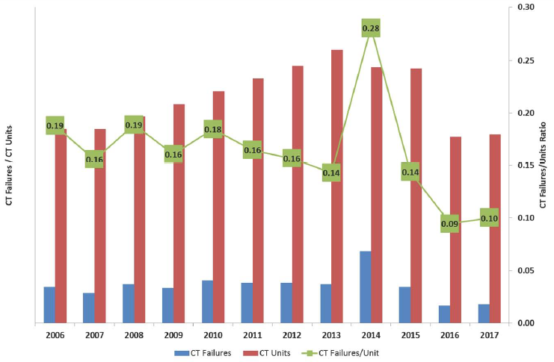
CT String Failures VS. CT Units

Slide 11
The range of this ratio was between 0.09 (2016) to 0.28 (2014) with an average of 0.16 failures per CT unit.

Slide 12
Corrosion
Storage Corrosion
Microbiological Influenced Corrosion (MIC)
Corrosion Operations
Influenced By
Influenced By
Abrasive fluids pumped through string
The Environment
The nature of the operation
The duration of exposure of the string with the Acid

Slide 13
Corrosion
Premature failure of the coiled tubing string caused by the action of corrosive environments on the coiled tubing.
Corrosion failures count for about 30% of the CT failures analyzed.
This type of damage can be internal or external and it is subdivided by the type of the corrosion damage.
CT corrosion failures can be subdivided by the source of the corrosion damage into:
Storage-Corrosion
Corrosion-Operations
Microbiological Influenced Corrosion (MIC)

Slide 14
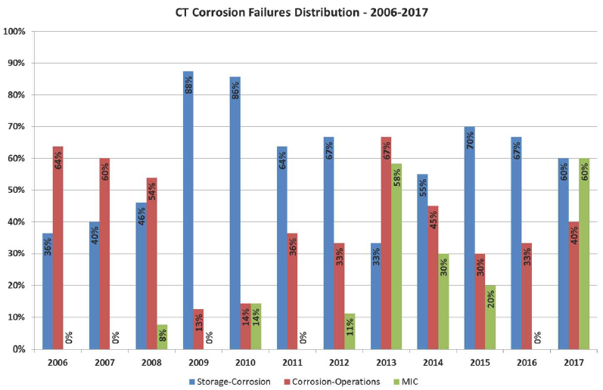
CT Corrosion Failures Distribution (2006-2017)

Slide 15
Storage Corrosion
The corrosion damage caused by the accumulation of corrosive fluids (within or outside the string) while it remains in storage for long periods (normally greater than 6 months).
The failure normally occurs by propagation of fatigue cracks from the corrosion damage.
Some guidelines established regarding “Storage-Corrosion” protection are directed towards:
Eliminating residual fluids
Application of “Corrosion Inhibitors” internally and externally, with a specific frequency
While string is in storage.
“Storage-Corrosion” has been the main cause of CT corrosion since 2009

Slide 16
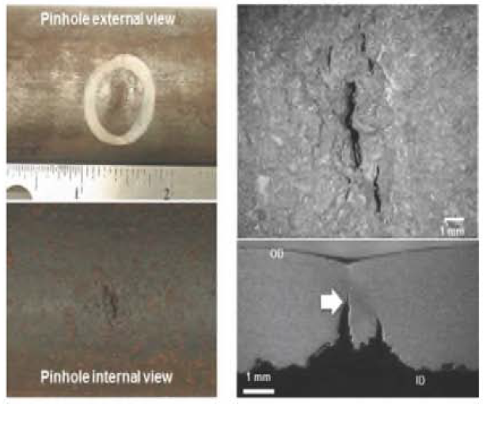
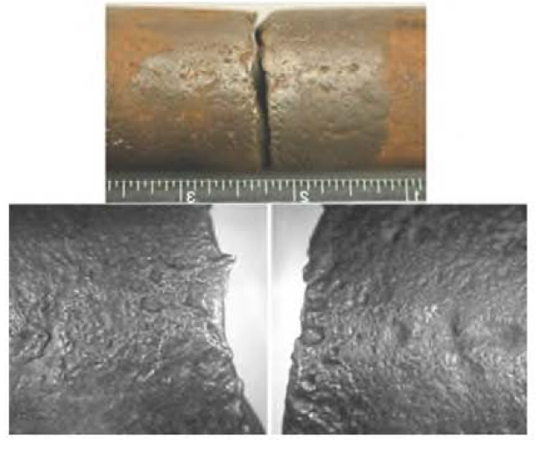
Internal
External
Storage-Corrosion

Slide 17
- Several actions are being taken to reduce the possibility of “Storage-Corrosion” failures:
Several failures were attributed to neutralizing with “Caustic Soda” following Acid operations.
This practice led to “Caustic Stress Cracking” that is a form of stress corrosion cracking in several strings.
An alert was issued and the practice banned.
2. Insufficient Nitrogen purging was identified as a contributing factor in several internal corrosion failures.
Correct procedure to continue circulating Nitrogen for longer durations following the purge, to lower the “Dew Point” and remove more water was updated.

Slide 18
3. A greater number of locations have been storing their strings inside or under “Tarpaulins” to protect from exposure to rain.
though caution has to be take with consideration build up in humid operating areas.
4. Trial of novel inhibitors.
For strings with a higher turnover, short operating life, a more operationally friendly corrosion inhibitor was trialed.
Positive results were obtained and it was approved and accepted for short-term corrosion protection.

Slide 19
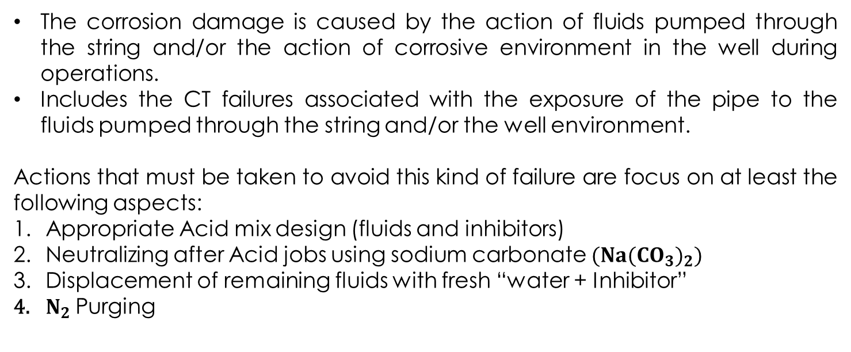
Corrosion Operations
The corrosion damage is caused by the action of fluids pumped through the string and/or the action of corrosive environment in the well during operations.
Includes the CT failures associated with the exposure of the pipe to the fluids pumped through the string and/or the well environment.
Actions that must be taken to avoid this kind of failure are focus on at least the following aspects:
Appropriate Acid mix design (fluids and inhibitors)
Neutralizing after Acid jobs using sodium carbonate ${(Na({CO}_{3})}_{2})$
Displacement of remaining fluids with fresh “water + Inhibitor”
$N_{2}$Purging

Slide 20
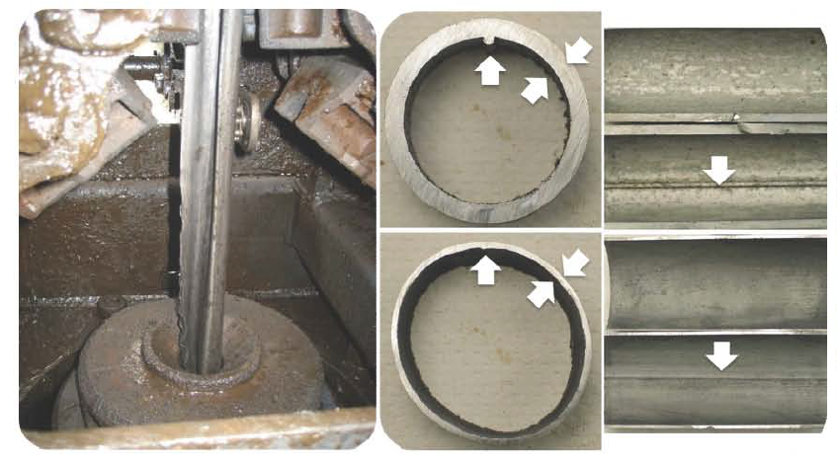
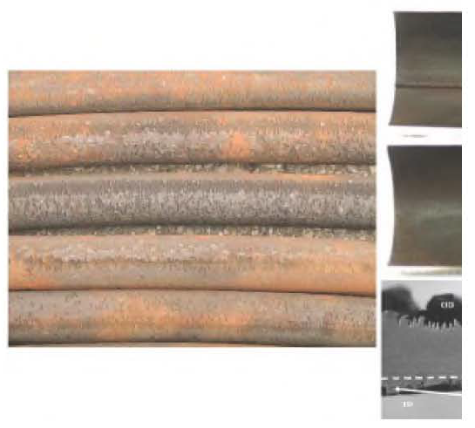
Internal
External
Corrosion-Operation By Exposure To Acid

Slide 21
The change from predominantly operational to predominantly Storage-Corrosion during this period significantly influenced by:
The reduction in Acidizing operations in North America
The increase in North America unit count
Change in job distribution to mostly support for shale fracturing (Perforation runs, plug Milling, or annular fracturing)

Slide 22
Microbiological Influenced Corrosion (MIC)
Failure caused by corrosion due to the presence of certain specific type of bacteria within the fluid in contact with the pipe.
Failure Mechanisms:
Fatigue cracking starting at internal pits associated with MIC
Sulfide stress cracking associated with the formation of “Localized Sour Environments” due to the presence of “SRB’s”.
In 2013, failures associated with MIC represented approximately 58% of the CT corrosion failures
This mechanism represented 30% of the CT corrosion failures in 2014.
There were few cases for which contamination of the water used for “Hydrotest” caused failures of new strings by MIC.

Slide 23
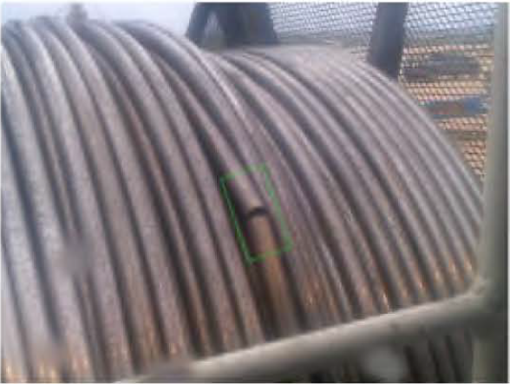
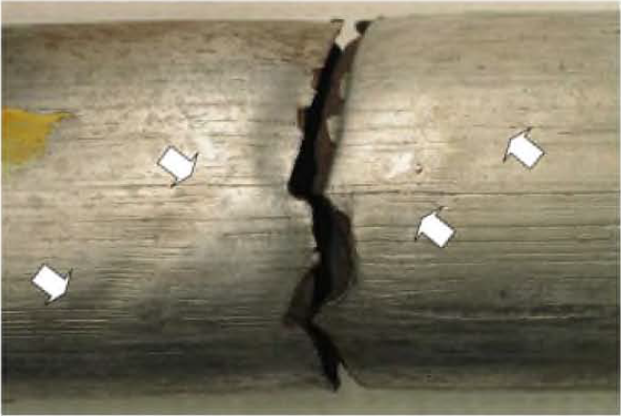
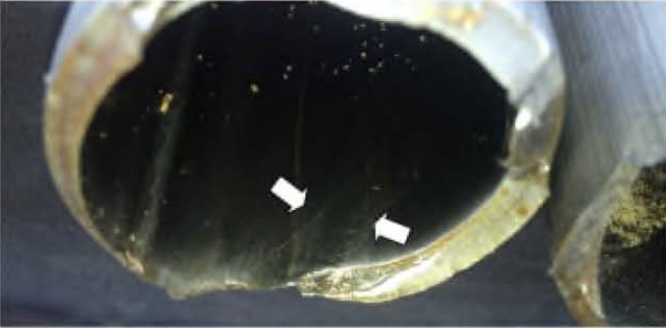

Slide 24
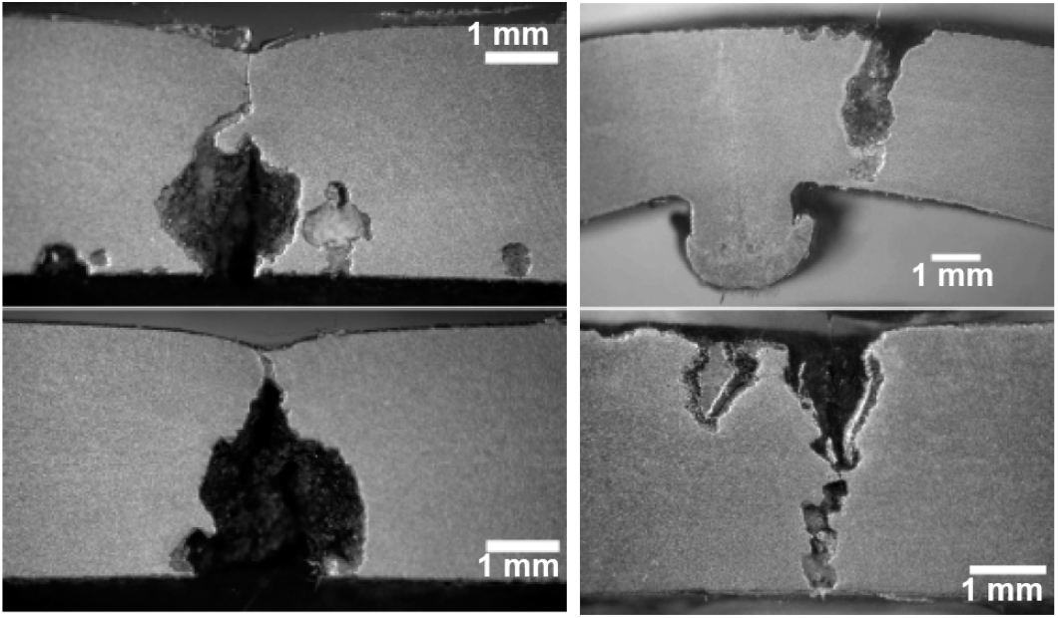
Internal
External
Severity of the Pitting Caused by MIC

Slide 25
MIC failures associated with the use/accumulation of water contaminated with bacteria had occurred in the past, mainly in the form of very severe, localized, and aggressive pitting corrosion.
MIC associated CT failures basically started to be a significant problem within the Coiled Tubing industry, as the fluid used for plug milling operations was changed to recirculated water.
Effects:
Very Severe
Localized
Aggressive
Pitting Corrosion

Slide 26
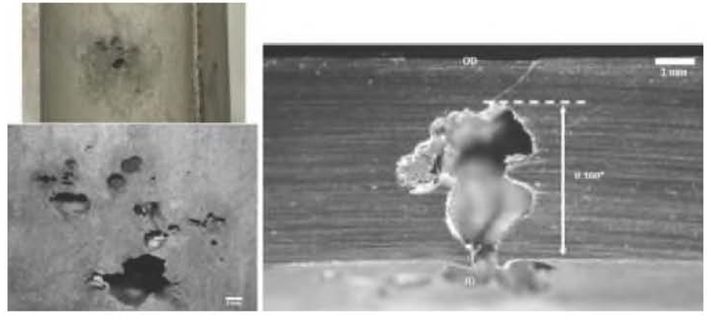
Pin Hole Due To Internal MIC

Slide 27
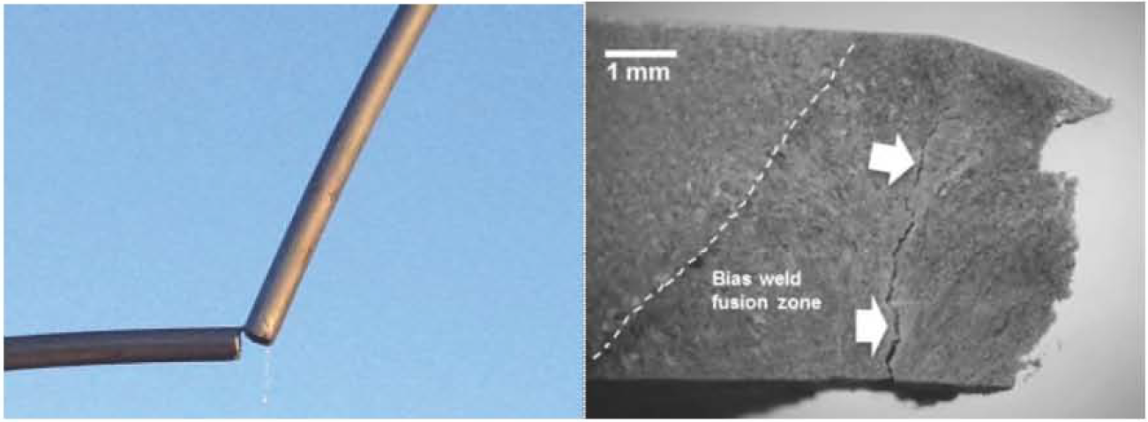
Fracture At Bias Weld Associated With MIC

Slide 28
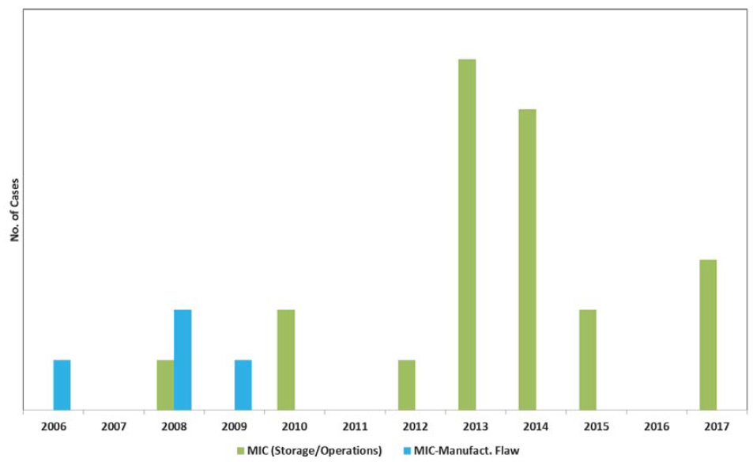
CT MIC Failures Distribution (2006-2017)

Slide 29
It is clear that MIC associated failures represented a significant issue in the years 2013 and 2014, which coincides with the use of recycled water for milling plugs jobs.

Slide 30
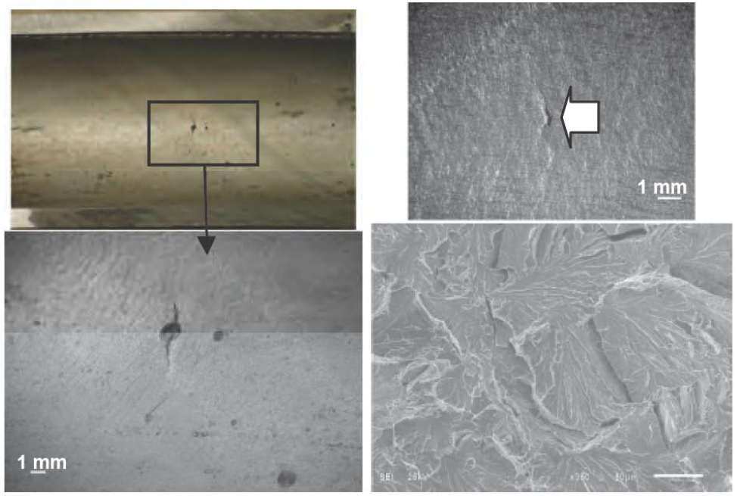
Fatigue Cracking Started by Internal Pit Caused by MIC
SSC Crack on the Pipe ID and Brittle Fracture Associated With It
MIC Failure Mechanisms

Slide 31
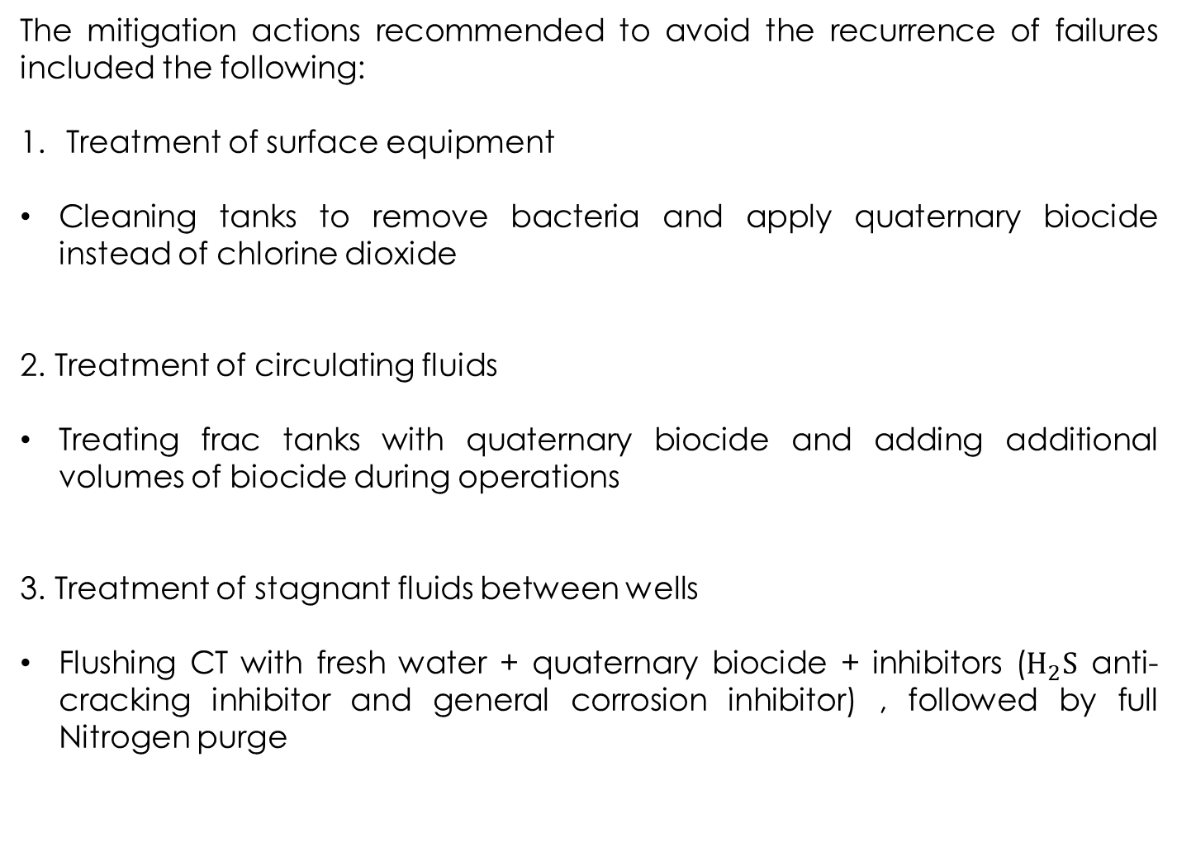
The mitigation actions recommended to avoid the recurrence of failures included the following:
Treatment of surface equipment
Cleaning tanks to remove bacteria and apply quaternary biocide instead of chlorine dioxide
2. Treatment of circulating fluids
Treating frac tanks with quaternary biocide and adding additional volumes of biocide during operations
3. Treatment of stagnant fluids between wells
Flushing CT with fresh water + quaternary biocide + inhibitors ($H_{2}S$ anti-cracking inhibitor and general corrosion inhibitor) , followed by full Nitrogen purge

Slide 32
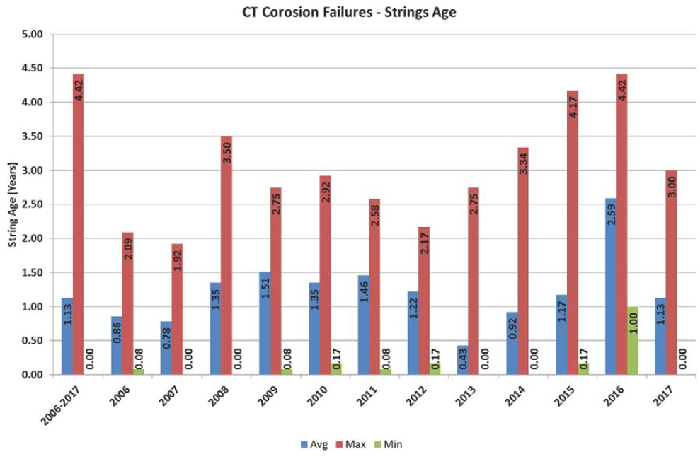

Slide 33
The average string age that failed by corrosion was 1.13 years for the whole period 2006-2017.
It can be seen that the average age from low values as 0.43 year sin 2013 to 2.59 years in 2016
The lowest value in 2013 is explained by the fact that several failures associated with MIC had an average service of around 27 days.
The high average of 2.59 years is related to a very low activity level for which only 3 cases of corrosion failures occurred.

Slide 34
Mechanical Damage
CT Surface Equipment
Damage Caused while RIH/POOH
Stem from
Caused by
Misuse the Equipment
Reel
Gooseneck
Mechanical Equipment Failure
Injector

Slide 35
Mechanical Damage
Longitudinal Plowing Marks (LPM)
Transverse Notch
External Dents
Circumferential Crushing (Pipe Crushing)
Pipe Slippage

Slide 36
Mechanical Damage
Premature fatigue failure of the coiled tubing string that starts at an external damage caused by mechanical means.
This mechanical damage constitutes a Stress/Strain concentration point which fatigue cracks can start and propagate causing a premature failure.
Mechanical damage failures represent close to 30% of the CT failures analyzed.
The most common types of “Mechanical Damage” found in CT strings are the following:
Longitudinal Plowing Marks (LPM):
This type of damage represented around 46% of the mechanical damages observed on CT strings for the period 2006-2017.

Slide 37
Transverse Notch:
This type of damage represents around 30% of the mechanical damages observed on CT strings within the 2006-2017.
Most of the time it is very difficult to establish the origin of this type of damage.
External Dents:
This type of damage represents around 11% of the mechanical damages observed on CT strings for the period 2006-2017.
It can be caused by loose broken items that find their way into the surface of the tubing by injector chains.
Circumferential Crushing:
This type of damage represents around 7% of the mechanical damages observed on CT strings.
It is normally associated with issues at the injector level.

Slide 38
In general, the solutions are oriented towards “Inspection” and “Maintenance” of the equipment in contact with the Coiled Tubing string.

Slide 39
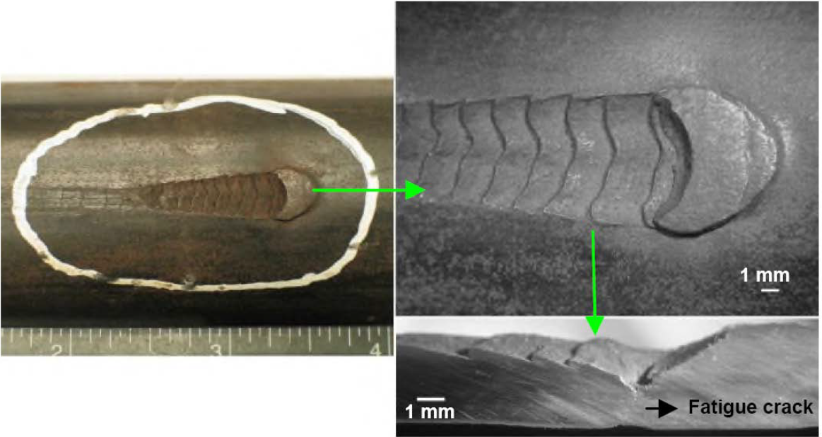
Longitudinal Plowing Marks (LPM)

Slide 40
LPM is not really a new failure mechanism, but its frequency has increased from 11% in the 2001-2005 period to around 46% for the 2006-2017 period.
LPM was the most common failure cause among external mechanical damage, representing 46% of all the failures associated with mechanical damage in the period 2006-2017 .
The most common cause of this type of damage is “Pipe Slippage” through the injector gripper blocks.
LPM failures normally occur as a “Transverse Crack” (i.e. Pinhole).
In order to reduce wear, injector gripper blocks are manufactured out of low alloy steel with surface hardening treatment leaves an average surface hardness of around 60 HRC.
CT pipe surface hardness is 22 HRC.
This is about 3 times the CT pipe hardness.

Slide 41
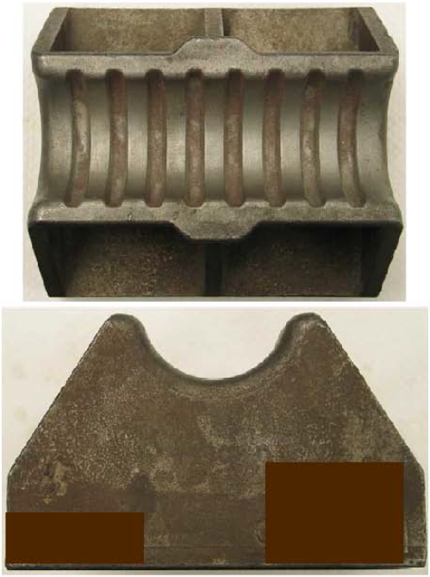
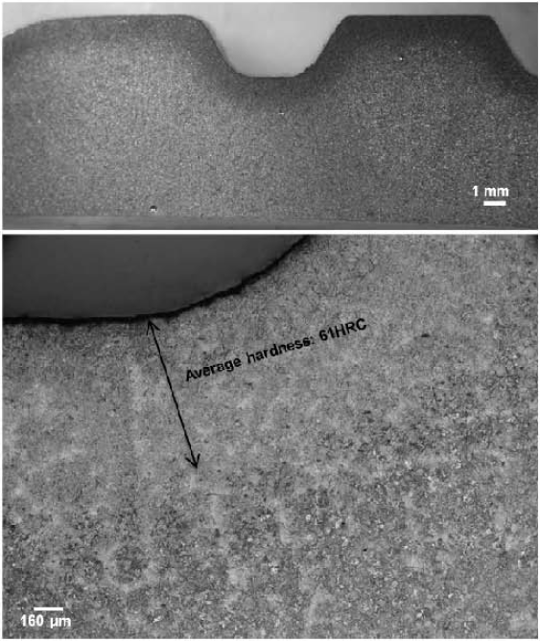
Gripper Block
Longitudinal Section Showing the Surface Hardening Treatment

Slide 42
Pipe Slippage:
When pipe slippage occurs, grippers surface can act as a “Chattering Cutting Tool” that leaves the LPM on the pipe.
Then, under additional bending cycles from the normal CT operations, a crack propagates causing the final “Pinhole”.
LPM cases started to increase around 2009, and in general, have kept at the level since then.

Slide 43
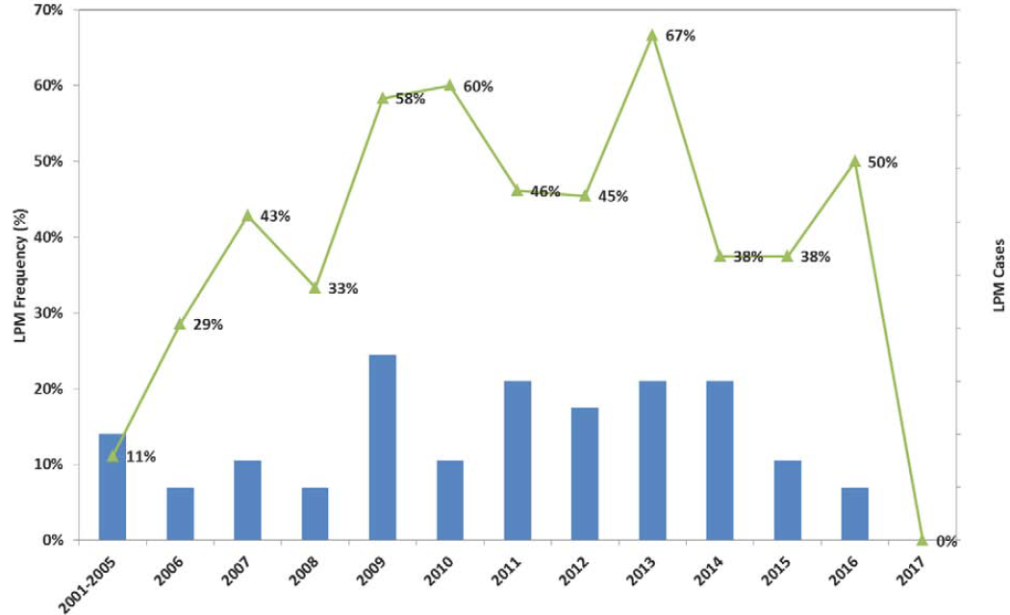
Trend of CT Failures Associated With LPM
(Frequency Within Mechanical Damage Classification)

Slide 44
There is a new injection system for which the removal of the timing gear left independent drive systems for each chain.
This system can cause one chain to slip with respect to the other, causing pipe slippage.
Cause
One chain slip with respect to the other
Pipe Slippage
Since the introduction of these injectors, the frequency of LPM failures increased significantly with disproportionate number of cases occurring with that style of injector head (25 cases out of 38, since 2009).

Slide 45
Cases still existed from timed injectors (13 cases since 2009), that is mainly caused by:
1. Increasing the traction pressure over that recommended by the “OEM”.
This is attributed to running with “Worn/Sharp” edged gripper inserts.
2. Operating with Non-Optimized chain tension.
Note: OEM = Original Equipment Manufacturer

Slide 46
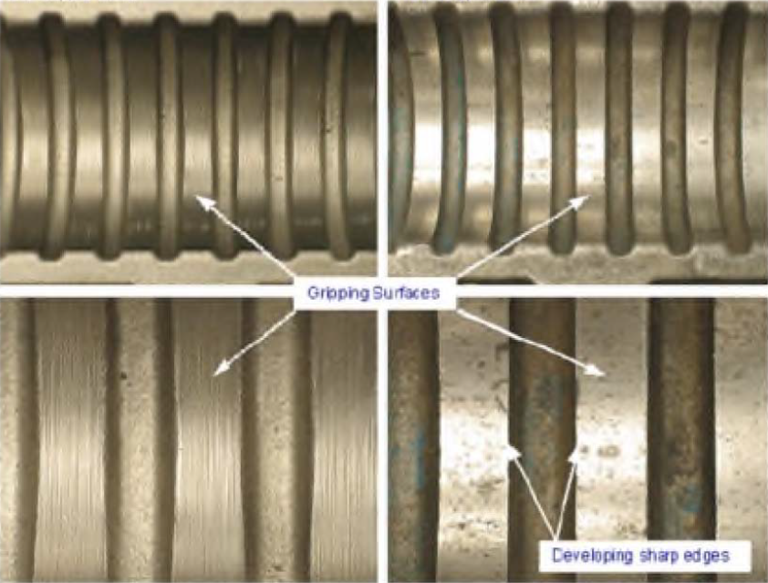
New Gripper Block
Worn Gripper Block

Slide 47
Some causes and recommendations to avoid mechanical damage in the form of LPM:
1. “Smooth” worn-out gripper blocks can cause a reduction of the friction force with the potential of causing pipe slippage.
Recommendations:
Replacing “Smooth” gripper blocks based on “OEM” recommendations.
Coating gripper blocks with “Tungsten Carbide” to increase the:
Roughness
Friction Force
2. The presence of material debris in the grooved gripper blocks could cause losing grip on the Coiled Tubing.
Recommendations:
Injecting the gripper blocks at the following times:
Prior to mobilization
Between wells
Post job

Slide 48
3. For injectors with systems for which the removal of the timing gear, there is the possibility that the hydraulic drive pressure could be different between the two independent drive systems of each chain. The difference in drive pressure can cause difference in torque delivered to the drive sprockets which can cause one chain to slip with respect to the other chain, causing “Pipe Slippage”.
Recommendations:
- A modification related to the installation of an injector pressure balance line should be implemented on the injector.

Slide 49
Manufacturing Flaws
Premature failure of a coiled tubing string that is associated with an issue created during the coiled tubing manufacturing process.
One of the most common manufacturing flaws reported is “Cold Weld” which is related with a lack of fusion at the longitudinal seam weld.
This type of damage represents around 8% to 20% of the CT failure causes.
This type showed an apparent downward trend.
“Manufacturing Flaws” were mainly associated with problems related to:
Seam Weld (Cold Weld)
Bias Weld

Slide 50
Human Error
In general, failures associated with human error caused an overload failure or buckling of the pipe.
In general, the number of failures associated with human error has been low (1 to 5 cases per year).
Whilst the frequency of string failures arising from human error has been relatively low, the resulting incidents are typically very high in profile.

Slide 51
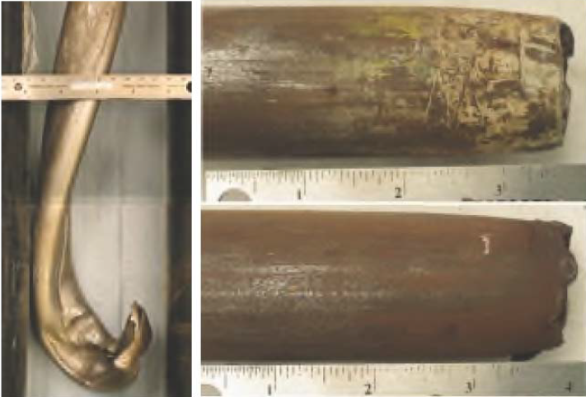
Pipe Buckling
Overload Failure
Human Error Examples

Slide 52
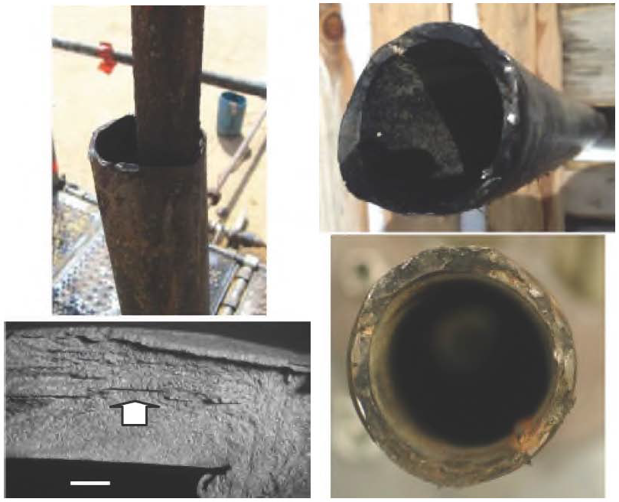
Hydrogen Induced Cracking (HIC)
Failure In Concentric Coiled Tubing
Sulfide Stress Cracking (SSC)

Slide 53
Pure Fatigue
Premature failure of the string by fatigue for which no external factor accelerated the fatigue failure.

Slide 54
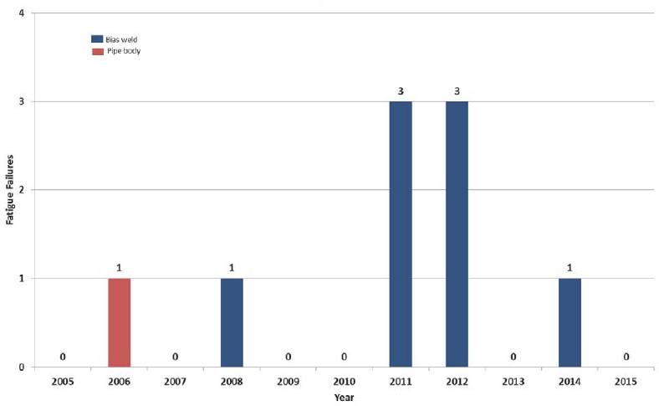
Fatigue on High-Strength Bias Welds (CT 100+)
“Pure” Fatigue Failures (Pipe Body and Bias Welds) (2005-2015)

Slide 55
Between 2005 and 2010, the total “Pure” fatigue failures per year oscillated between 0 and 1 .
Between 2011 and 2014, 7 cases of CT failures associated with “Pure” fatigue on bias welds had been experienced .
6 of these failures occurred on High-Strength Coiled Tubing Grades (CT 100+)
These cases represented a warning signal, because “Pure” fatigue failures in Coiled Tubing strings are not common.
Before the “Pure” fatigue failures on bias welds, the service companies approach regarding bias welds fatigue life was to consider that it was the same as the pipe body.
This approach was based on the fact that the bias weld fatigue life fell within the pipe body range of specific Grade, because its fatigue models use a 1:1000 probability of failure.

Slide 56
de-rating factors for the bias welds fatigue life:
For straight bias welds: Around 20% less than the pipe body
For stepped bias welds: Around 50% less than the pipe body
* Stepped bias welds = True-Taper bias welds
Service Companies used the approach of including de-rating factors for the bias welds fatigue life, regardless:
1.Coiled Tubing Grade
2. Level of strain at the bias weld
For straight High-Strength bias welds (Grade 100+) it’s confirmed that the average bias weld/pipe fatigue life ratio decreased as the strain on the bias weld increased, obtaining bias weld fatigue values as low as 66% of the pipe body at 2.5% strain.

Slide 57
External Abrasion
Failure associated with a localized reduction of wall thickness by external abrasion, normally associated with friction between the coiled tubing and the well completion (flat spool).

Slide 58
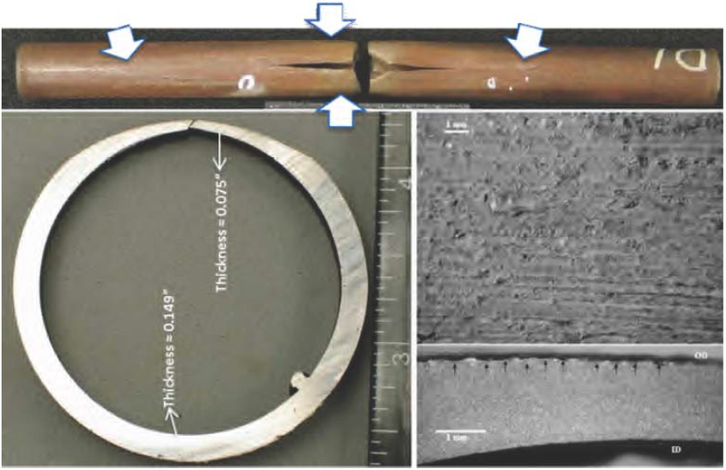
External Abrasion (Flat Spot)

Slide 59
Erosion
Localized failure associated with the action of fine particles erosion, like for example fluids transporting sand.

Slide 60
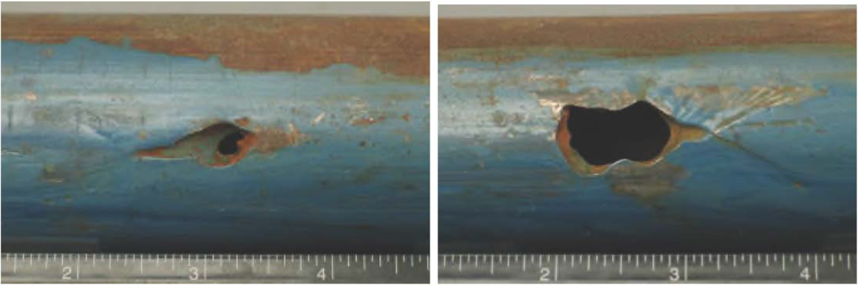
External Erosion Caused By The Action of Fluids Transporting Sand

